Slide 1
Model Robustness using Dropout Regularization on MNIST
Machine Learning Assignment 27
By: Rishi A Sheth PES2UG23CS479, Rithvik Matta PES2UG23CS485

Slide 2
Background and Motivation
Deep neural networks often overfit training data, reducing generalization.
Dropout regularization prevents neuron co-adaptation by randomly deactivating neurons during training.
Helps improve model robustness and generalization.

Slide 3
Objective
Implement a simple MLP on MNIST for handwritten digit classification.
Systematically analyze impact of varying dropout rates (0.0, 0.2, 0.5) on accuracy and variance.
Assess training vs validation accuracy and prediction stability over multiple runs.

Slide 4
Dataset and Preprocessing
MNIST dataset: 60,000 train and 10,000 test grayscale images, 28x28 pixels.
Flattened into 784-dimensional input vectors.
Normalized pixel values
One-hot encoded labels for classification.

Slide 5
MLP Architecture & Training Setup
Output layer: Dense 10 units with softmax.
Dropout applied after each hidden layer with rates: 0.0 (baseline), 0.2, 0.5.
Training: Adam optimizer, batch size 128, 15 epochs.
Each dropout setting repeated 3 times for variance analysis.
Input: 784 units (flattened pixels)
Hidden layers:
Dense 512 units + ReLU + Dropout
Dense 256 units + ReLU + Dropout
Dense 128 units + ReLU + Dropout

Slide 6
Training & Validation Accuracy Curves
Line graph showing training and validation accuracy across epochs for dropout rates 0.0, 0.2, 0.5.
Highlight differences in training accuracy and validation accuracy trends.

Slide 7
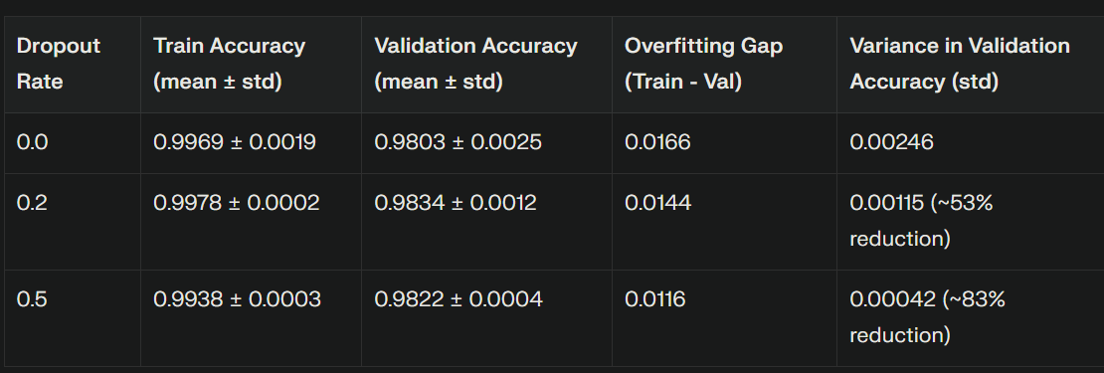
“This is a super-important quote”
Quantitative Results Summary
- From an expert

Slide 8
Variance and Stability Analysis
Discussion: How Dropout Works
Dropout randomly disables neurons during training, training many thinned subnetworks.
At inference, using all neurons approximates averaging an ensemble of models.
Reduces co-adaptation and overfitting.
Tradeoff: higher dropout encourages regularization but reduces capacity and training accuracy.
Dropout reduces prediction variance significantly.
Higher dropout (0.5) yields lowest variance and overfitting gap, but slightly lower validation accuracy.
Moderate dropout (0.2) balances between accuracy and stability.

Slide 9
Practical Recommendations
Start with dropout 0.2 for dense MLPs on clean datasets like MNIST.
Increase to 0.5 if overfitting or variance across runs is observed.
Report mean and standard deviation over multiple runs.
Include learning curves and confusion matrix to analyze errors.

Slide 10
Conclusion
Dropout improves generalization and run-to-run stability.
Dropout 0.2 gives best validation accuracy; dropout 0.5 provides best stability and lowest overfitting gap.
Dropout rate choice depends on balancing peak accuracy vs stability.

Slide 11

Thanks!

